Slide 1
Image Captioning using CNN and RNN
Group 11
Sai Surya Vidul Chinthamaneni
Devaki Kalyan Chandra Yadav Podila

Slide 2

INTRODUCTION
What is Image Captioning?
Definition: Image captioning is the process of creating a textual description for a digital image
Technological Intersection:
Computer Vision: Analyzes and interprets what is depicted in the image.
Natural Language Processing: Generates coherent and contextually relevant text based on the visual input.
Why is it Important?
Accessibility: Enhances the accessibility of visual content for those with visual impairments by providing descriptive text of visual elements.
Content Management: Facilitates better organization and retrieval of digital media by providing searchable text that describes image content.
Automation: Useful in automated systems for generating descriptions in dynamic environments, such as news reporting or security systems.

Slide 3
PROBELM FORMULATION
MAJOR COMPONENTS IMPLEMENTED
Generate captions for images using the CNN-RNN model
Implementation of pre-trained CNN model
Implementation of the LSTM model with attention mechanisms (soft and hard)
Evaluation and Comparison with BLEU scores.

Slide 4
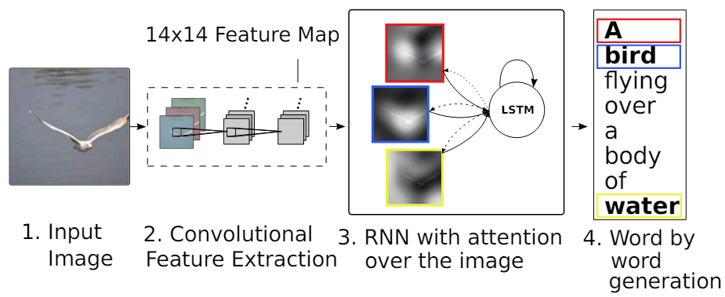
Overview of the Model Architecture
Combining CNN and RNN
CNN (Convolutional Neural Network):
Model Used: VGG16.
Purpose: Extracts detailed features from images, which includes recognizing various patterns and characteristics crucial for understanding the visual content.
Strength: VGG16 is known for its deep architecture, which allows it to capture complex features at various levels, making it highly effective for tasks requiring detailed visual understanding.
RNN (Recurrent Neural Network):
Specific Type Used: LSTMs (Long Short-Term Memory networks).
Purpose: Handles the sequential generation of captions based on the features extracted by the CNN.
Strength: LSTMs are particularly adept at managing long sequences, crucial for maintaining context and coherence over the span of entire sentences or captions.

Slide 5
Overview of the Model Architecture
Purpose of Attention Mechanisms
Function: Enhance model focus and efficiency by selectively processing parts of the input relevant to generating the output.
Goal: Improve the accuracy and relevance of outputs in tasks that merge sequential data processing with contextual awareness, such as image captioning.
Specific Type Used: Both Soft and Hard Attention
Strength:
Enhanced Contextual Relevance: Attention mechanisms prioritize relevant input features, ensuring output generation is directly influenced by the most pertinent data, enhancing the accuracy and relevance of results.
Improved Interpretability and Efficiency: Attention provides clear insights into which parts of the input data the model considers important, improving transparency, and selectively processing information to boost computational efficiency.

Slide 6


SOFT ATTENTION
It is a deterministic approach.
Soft attention involves looking at all parts of an image simultaneously but with varying levels of focus. Each part of the image is assigned a weight that indicates its importance. The model then considers all parts of the image, but gives more emphasis to the parts with higher weights.

Slide 7
HARD ATTENTION
It is a stochastic approach.
Hard attention involves making a discrete choice about which part of the image to focus on at each timestep. Instead of considering all parts of the image simultaneously, the model selects one part to focus on. This approach makes the model's decisions more concentrated, but also more complex to train.

Slide 8
EXPERIMENTS
We have used a train/test split of 80/20 of the Flickr8k datatset.
We utilized VGG-16 as Encoder and LSTM (along with soft and hard attention) as Decoder
Number of Epochs - 10
For loss calculation we have use Cross Entropy loss and optimization of parameters is done using Adam.
We have done 3 experiments
Base Implementation
Base with Soft Attention
Base with Hard Attention

Slide 9
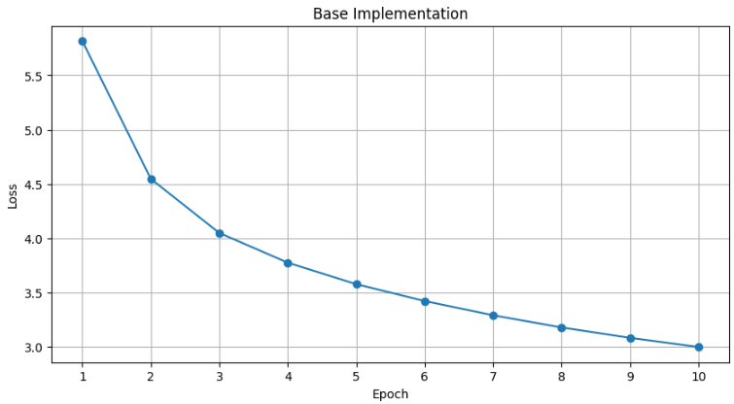
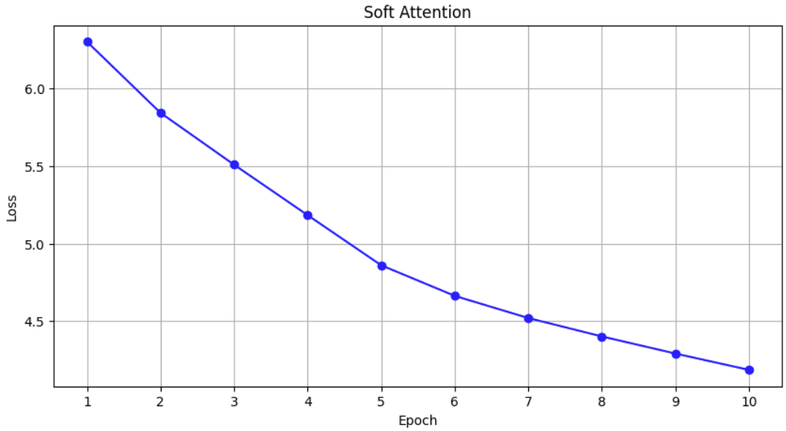
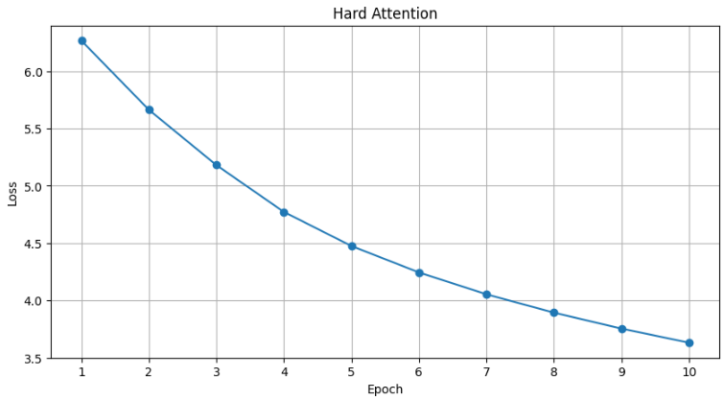
RESULTS- LOSS

Slide 10
RESULTS-BLEU SCORES
MODEL | BLEU-1 | BLEU-2 | BLEU-3 | BLEU-4
BASE | 0.2788 | 0.1206 | 0.0617 | 0.0238
SOFT ATTENTION | 0.3567 | 0.1869 | 0.0973 | 0.0457
HARD ATTENTION | 0.3380 | 0.1727 | 0.0883 | 0.0391
Reference paper for optimal ranges of BLEU scores for image captioning models - “Where to put the Image in an Image Caption Generator" (2017)”

Slide 11
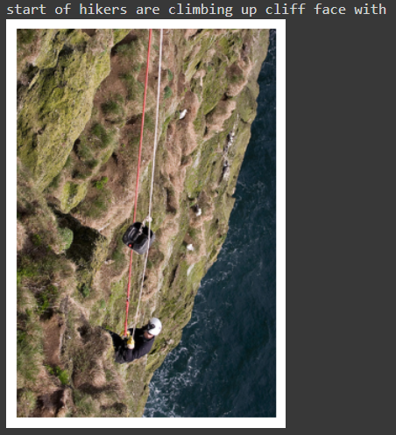
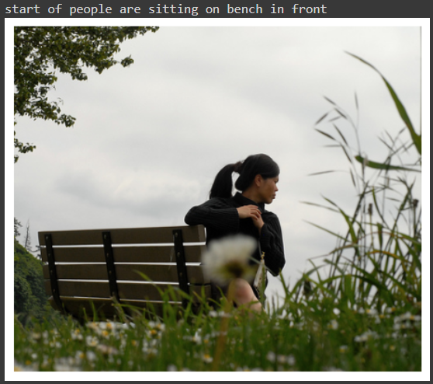
RESULTS- BASE CAPTIONS

Slide 12
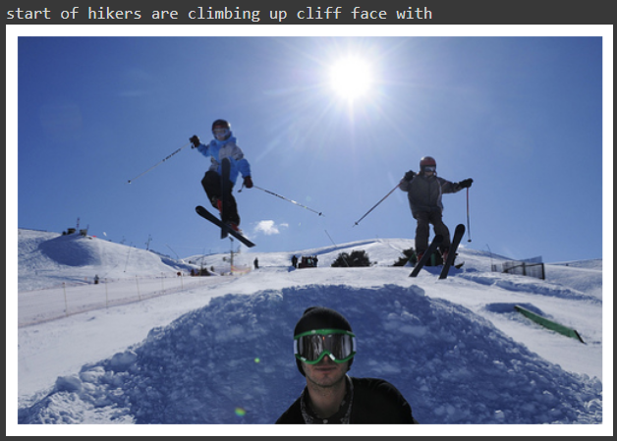
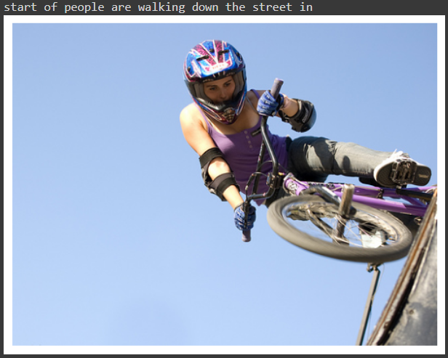
RESULTS-BASE CAPTIONS

Slide 13
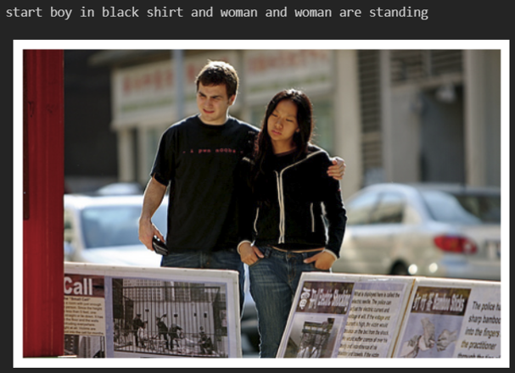
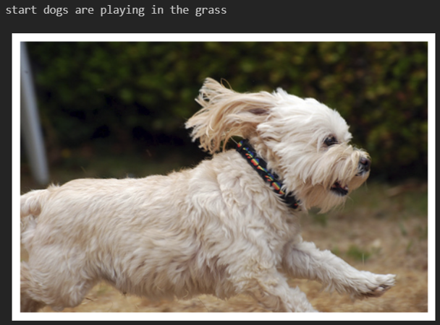
RESULTS- SOFT ATTENTION CAPTIONS

Slide 14
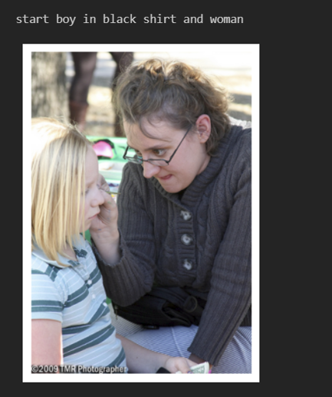
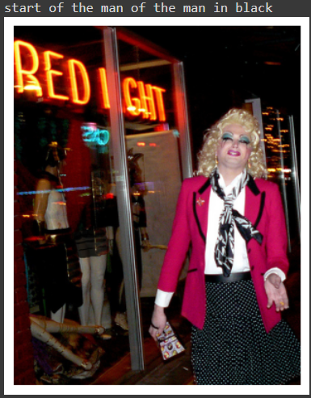
RESULTS- SOFT ATTENTION CAPTIONS

Slide 15
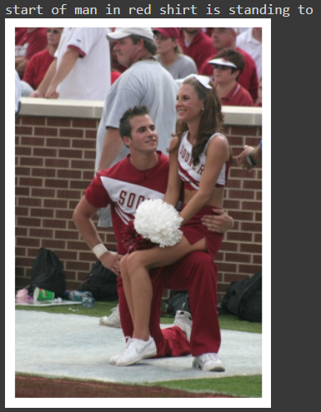
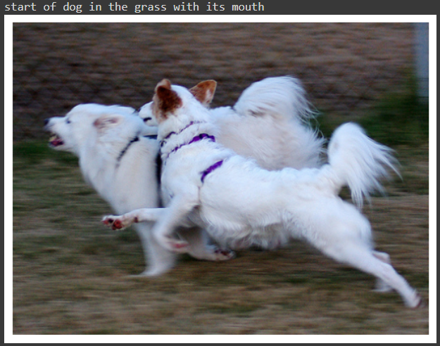
RESULTS- HARD ATTENTION CAPTIONS

Slide 16
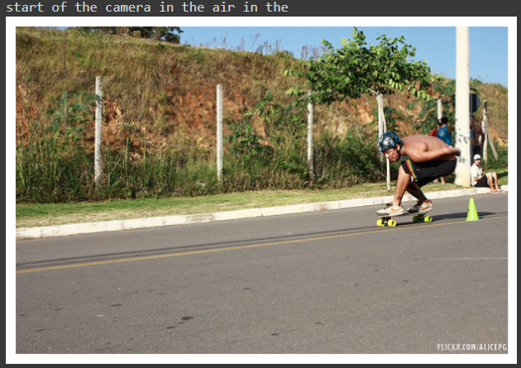
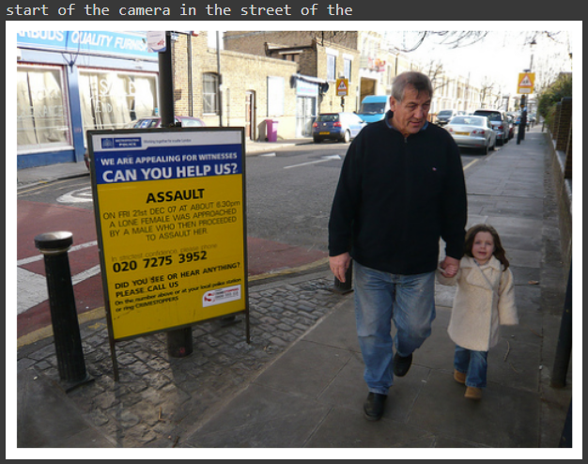
RESULTS- HARD ATTENTION CAPTIONS

Slide 17
FUTURE DIRECTION
Implementation of more metrics such as ROUGE and METEOR scores, in order to better understand and evaluate the models.
More fine tuning and implementation the CNN model from scratch, thus tailoring it better for task.
Exploring the use of Transformer-based attention mechanisms, which have shown superior performance in such NLP based tasks.
Training the models on other datasets such as Flickr30k and MS COCO and implementation of additional strategies such as dropout, data augmentation, random cropping and so on.

Slide 18
THANK YOU

